Slide 1


Slide 2
What is support vector machine?
Support vector machine(SVM) is a supervised machine learning algorithm used for classification and regression tasks.
Most commonly used in classification objectives.
It uses the technique known as ‘The kernel Trick’ to transform the data and finds an optimal boundary between the possible outputs.

Slide 3

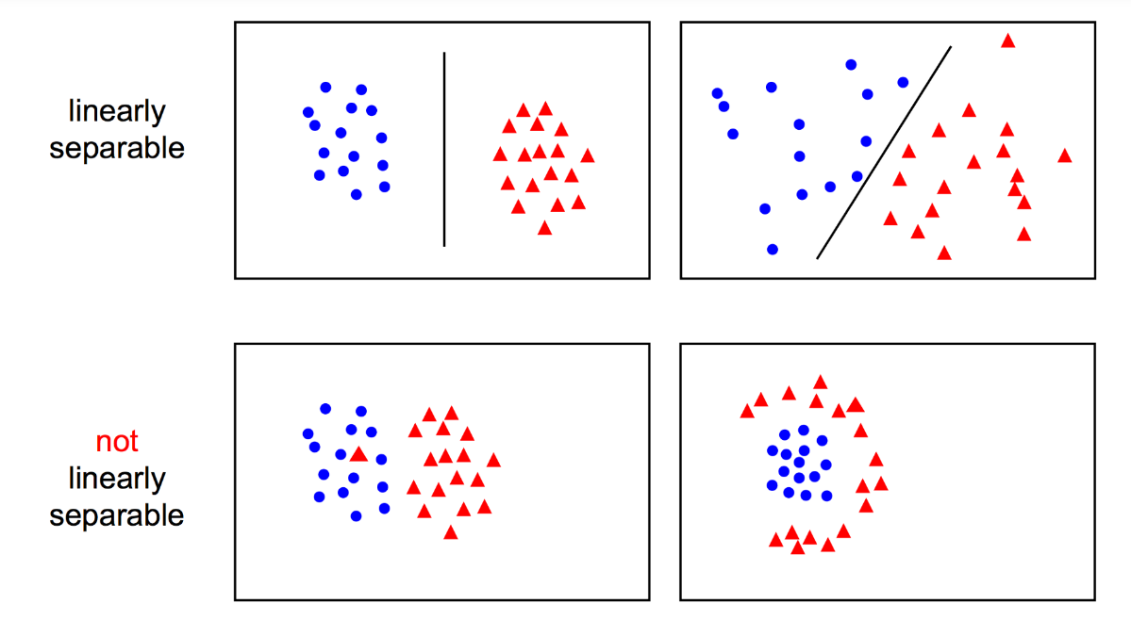
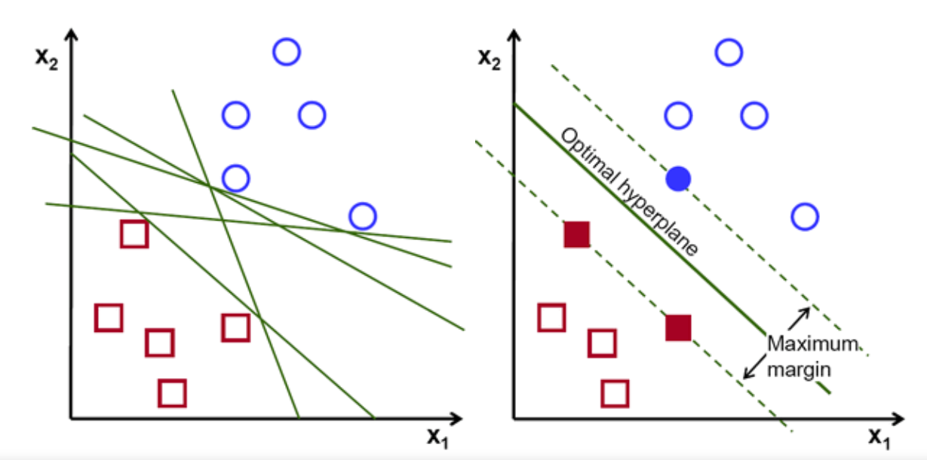
Objective:
The objective is to find a hyperplane in an N-dimensional space(N is no of features/attributes) that distinctively classifies the data points.
They can be linear separable and non-linear separable too.
To separate the data points, many possible hyperplanes can be chosen but the most effective is the one with maximum margin.
Maximizing the margin provides some reinforcement so that future data points can be classified with more confidence.

Slide 4
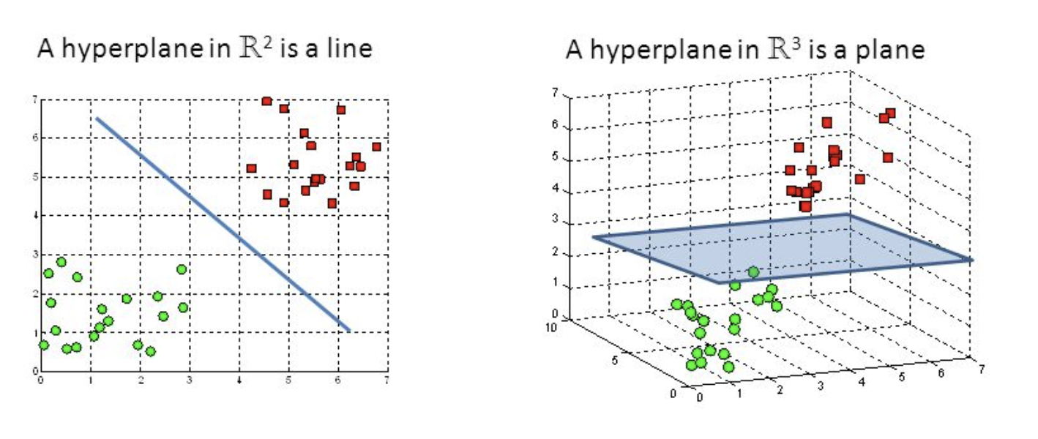
Hyperplanes and support vectors
Hyperplanes are nothing but decision boundaries that help classify the data points.
Data points falling on either side of the hyperplane can be attributed to different classes.
As already said, the dimension depends upon the number of features/attributes we have for any given data.
Support vectors are data points that are closer to the hyperplane and influence the position and orientation of the hyperplane.

Slide 5
Real world applications:
Face Detection
Protein structure prediction
Hand writing prediction
Breast cancer diagnosis
Intrusion detection
Classification of images

Slide 6
SVM in face detection
SVM classifies the parts of the image as face and non-face.
It contains training data of nxn pixels with 2 classes face(+1) and non-face(-1).
Then it extracts features from each pixel as face and non-face.
Creates boundaries around faces on the basis of brightness and classifies each image by using the same process again.

Slide 7
Application using SVM:
Problem statement:
You’re a farmer, you have cows and you’ve to protect them from wolves.
Where do you build your fence?
Using SVM,
You could build a classifier based on the position of the cows and wolves in your pasture.
Racehorsing a few types of classifiers, we see that SVM does a good job in separating cows from wolves.

Slide 8
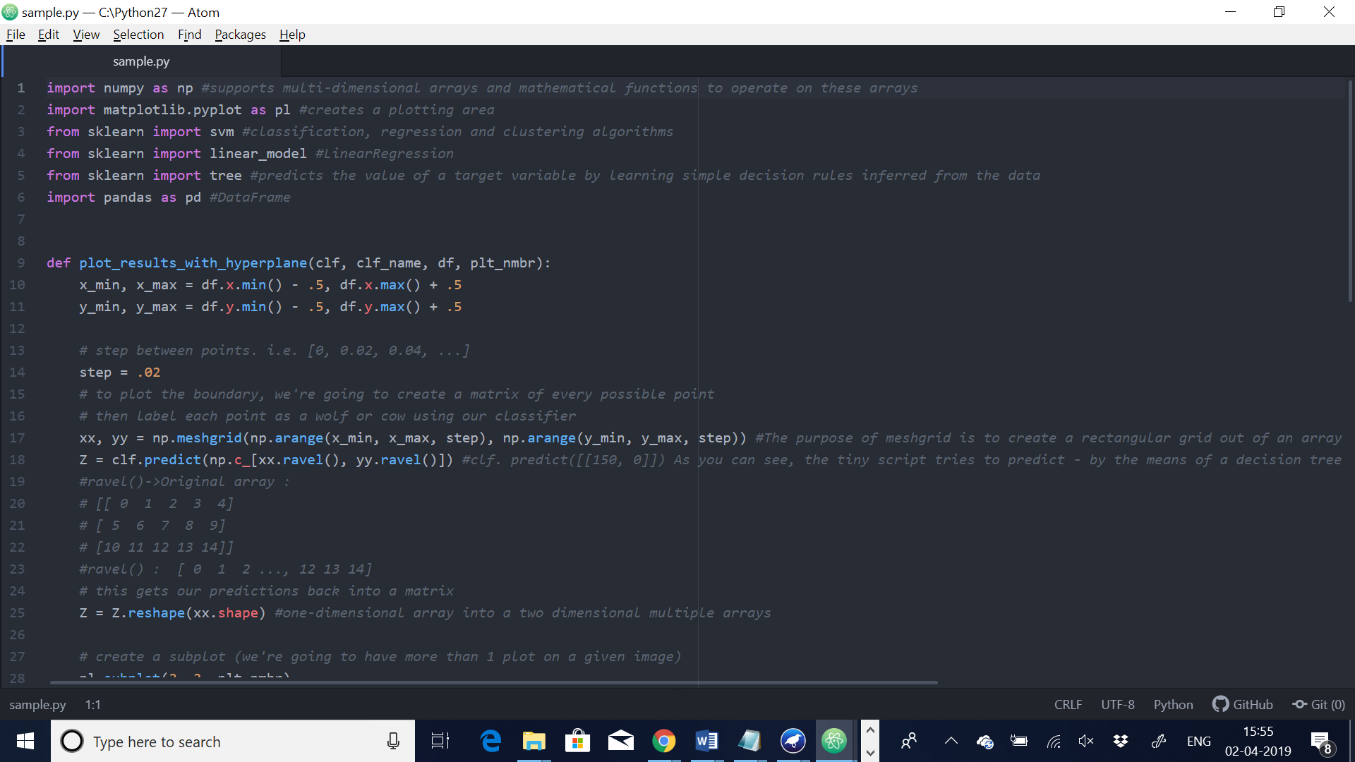

Slide 9
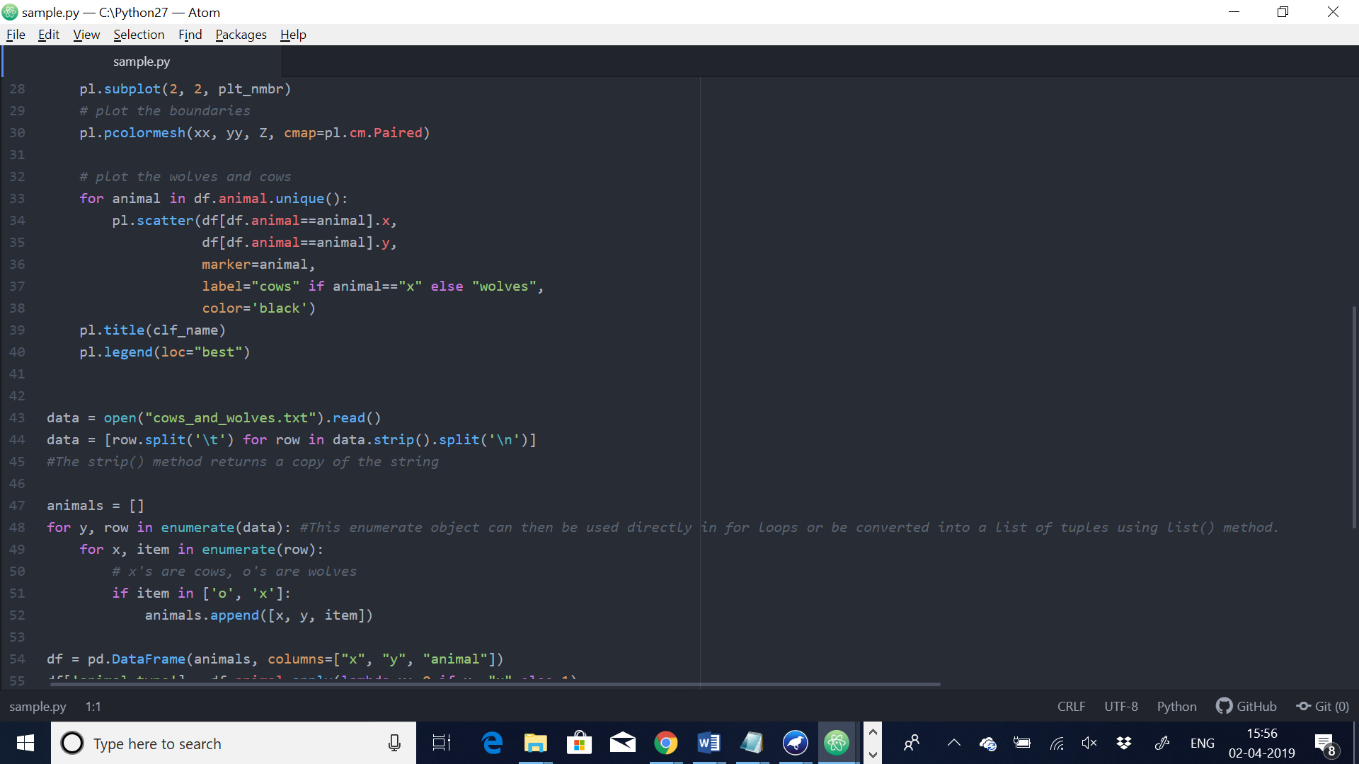

Slide 10
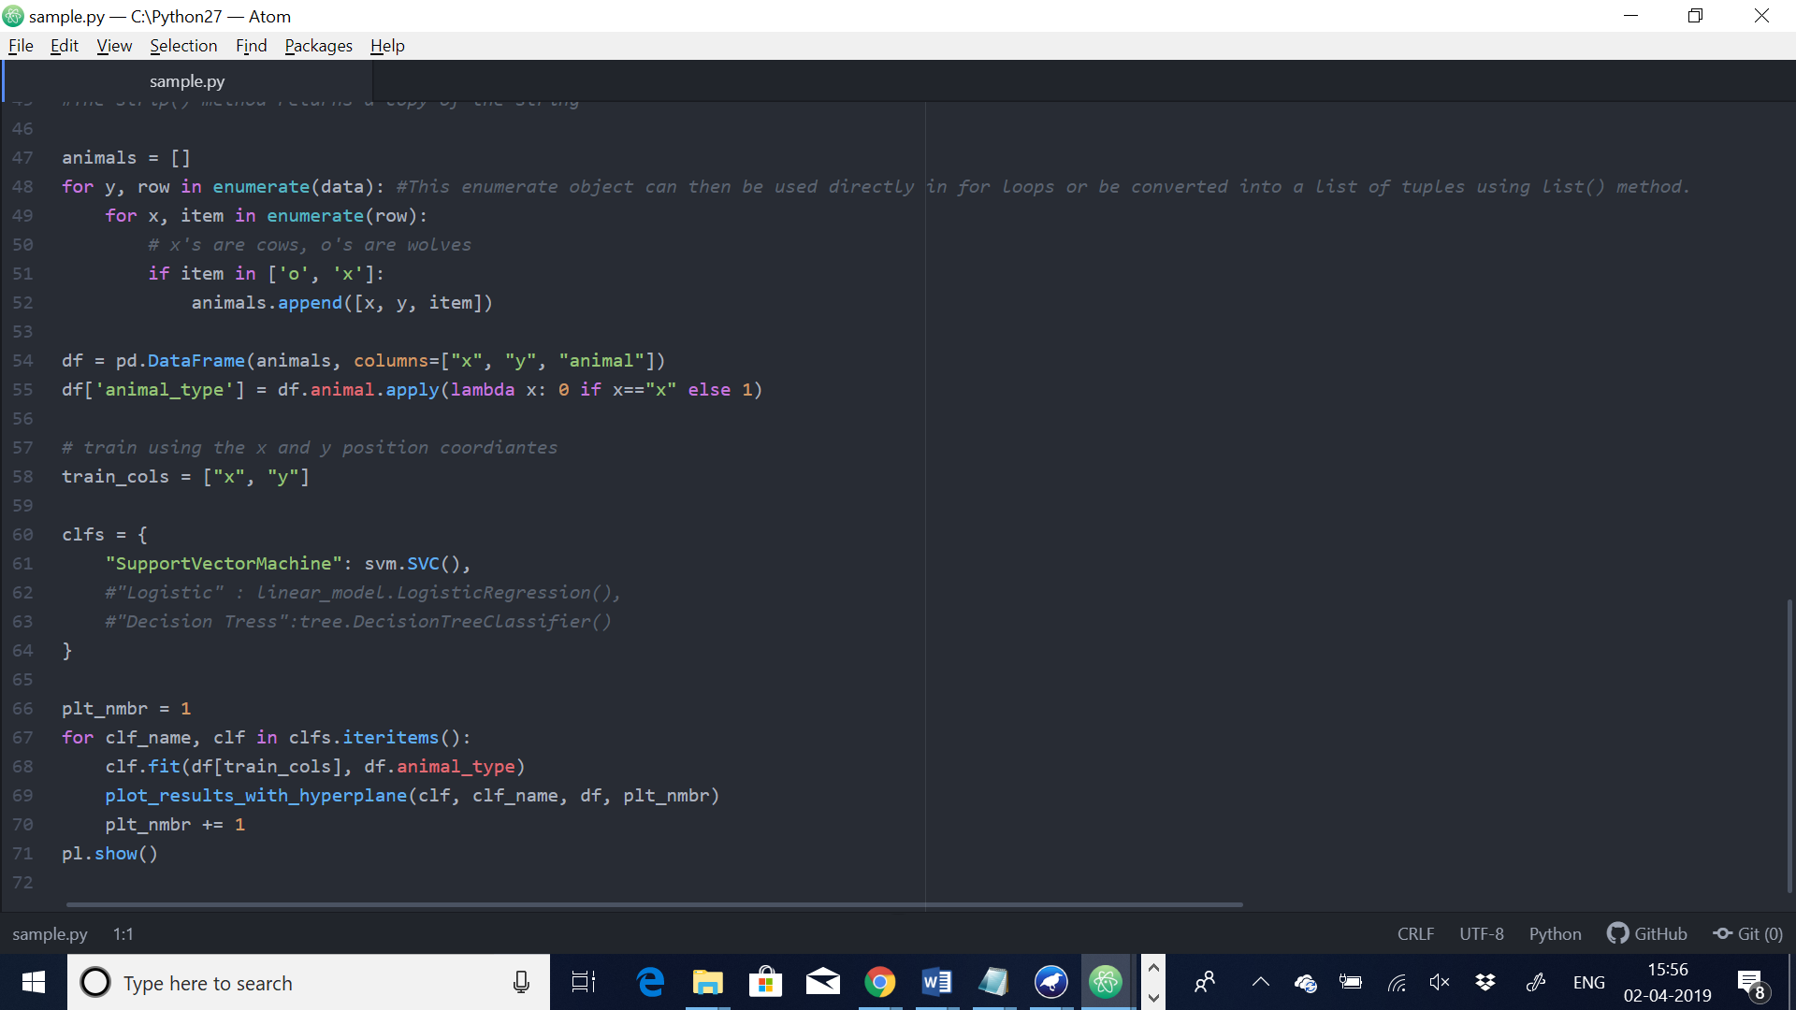

Slide 11
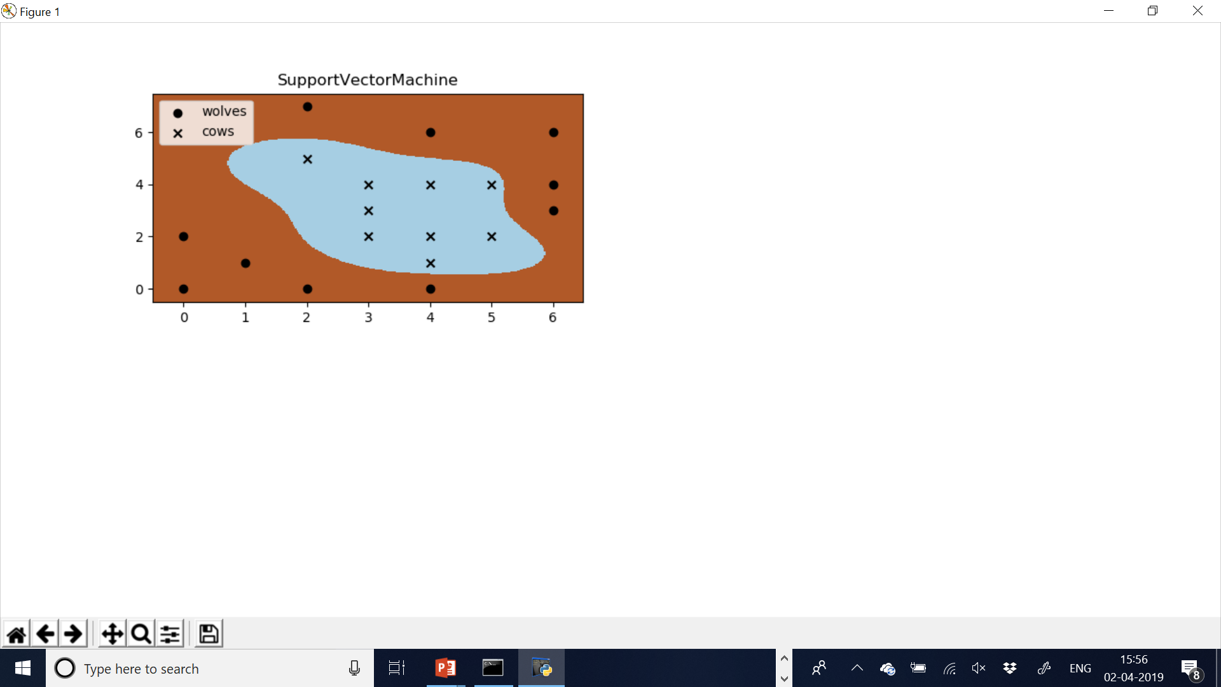

Slide 12
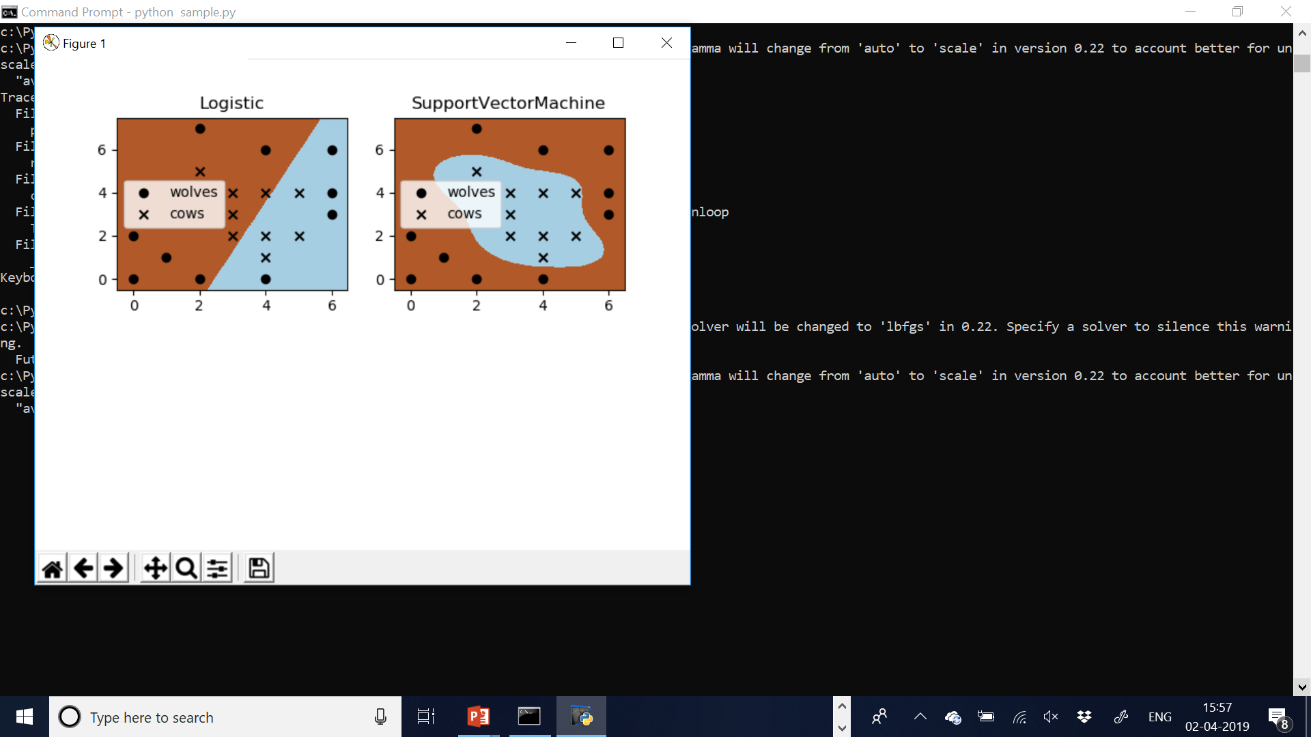

Slide 13
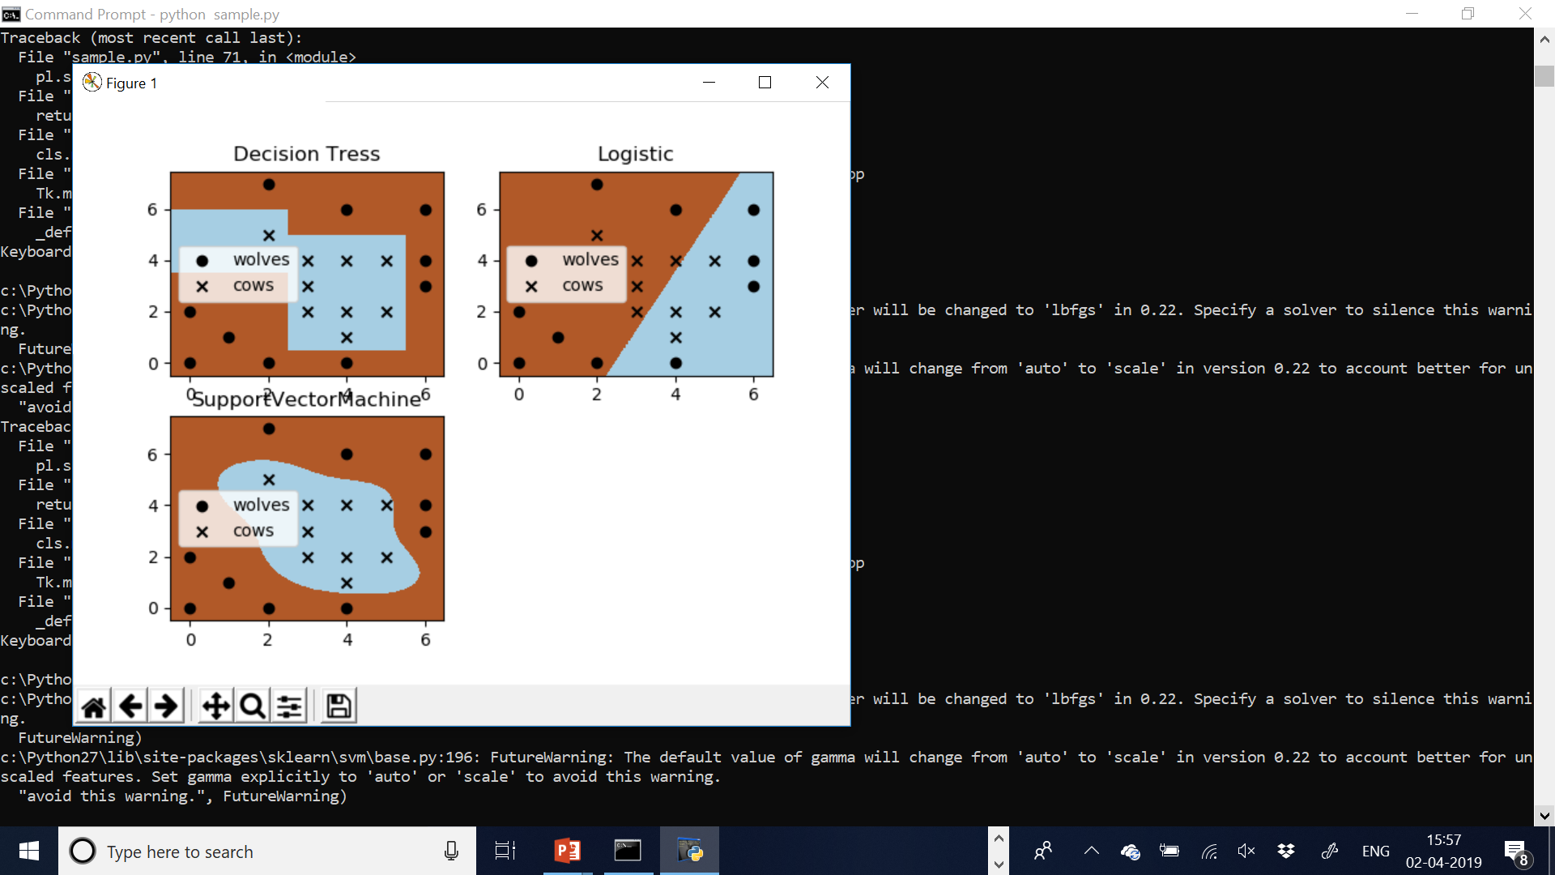

Slide 14
Advantages:
Most effective in high dimensional spaces, because we can use any other algorithm when it comes to 2D and 3D.
Effective in cases where number of dimensions is greater than number of samples.
Versatile, different kernel functions can be specified for the decision function. Common kernels are provided, also possible to specify custom ones.

Slide 15
Disadvantages:
If number of features is much greater than number of samples, avoid over-fitting in choosing kernel functions.
Long training time for large datasets.
Choosing a good kernel function is not easy.

Slide 16
REAL WORLD CASE STUDY

Slide 17
Drug Discovery
Using Support Vector Machines

Slide 18
The drug discovery process traditionally involves an iterative procedure of finding compounds that are active against a biological target. It is more efficient to test multiple compounds in parallel. However, often only a small number of chemical classes can be pursued in parallel. The idea is to refine the model of activity in each step, based on all tested compounds at hand and to choose the most promising compounds for the next batch. The cycle is repeated until the ultimate goal is achieved, i.e., active compounds with good enough properties for a clinical trial are found.(Pattern recognition) SVM solves this problem by 1) allowing some data points to the wrong side of the hyperplane by introducing a user-specified parameter C that specifies the trade-off between the minimization of the misclassifications and maximization of margin; 2) using kernel functions (usually including linear, polynomial, sigmoid, and radial basis functions (RBF)) to add more dimensions to the low dimensional space, as a result that two classes could be separable in the high dimensional space.

Slide 19
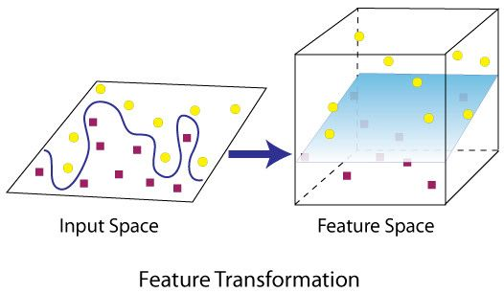

Slide 20
Conclusion:
SVM is a useful alternative to neural networks
Two key concepts of SVM: maximize the margin and the kernel trick
Many SVM implementations are available on the web for you to try on your data set!

